Slide 1
Arduino Basics
With Preston Reed

Slide 2
What is an Arduino?
An Arduino is a microcontroller
Sensors
Microcontroller
Actuators

Slide 3
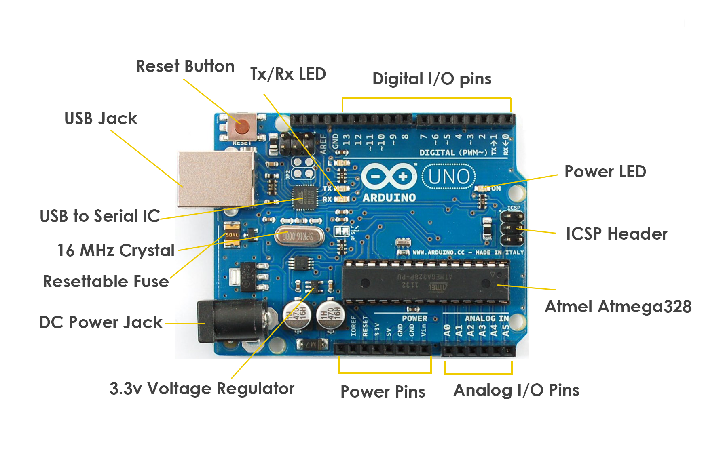
Board Layout

Slide 4
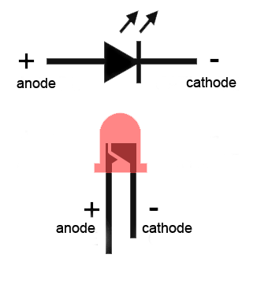
Circuit Components
1) LED

Slide 5
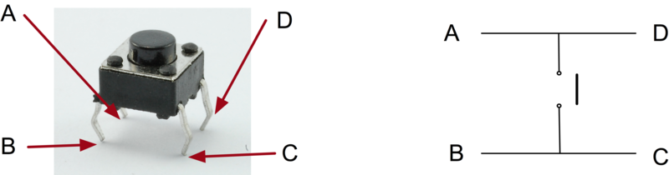
2) Switch

Slide 6
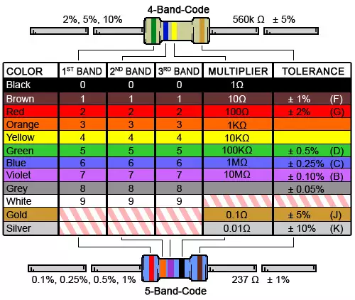
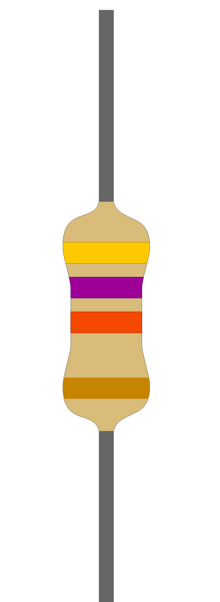
3) Resistor

Slide 7
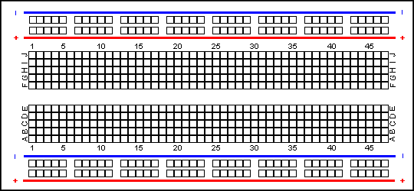
Breadboard

Slide 8
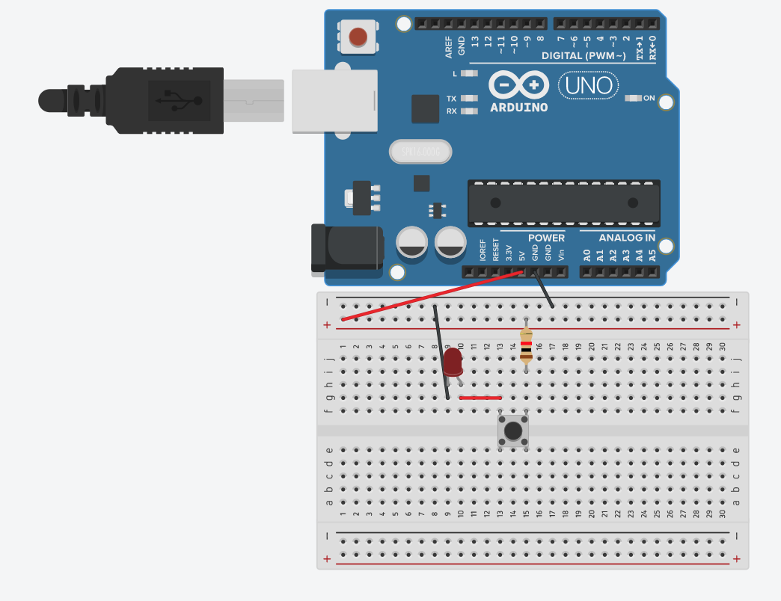
Activity

Slide 9
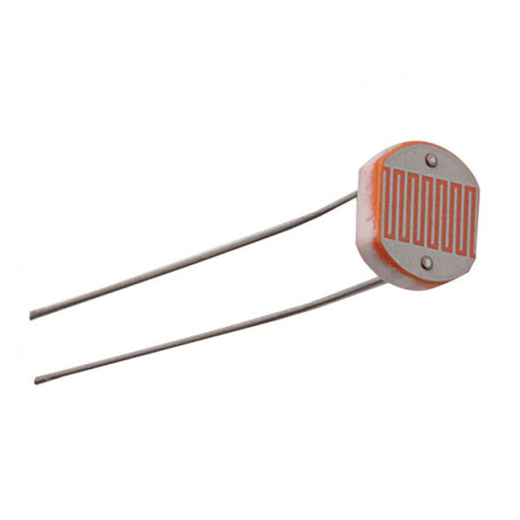
Photoresistor

Slide 10
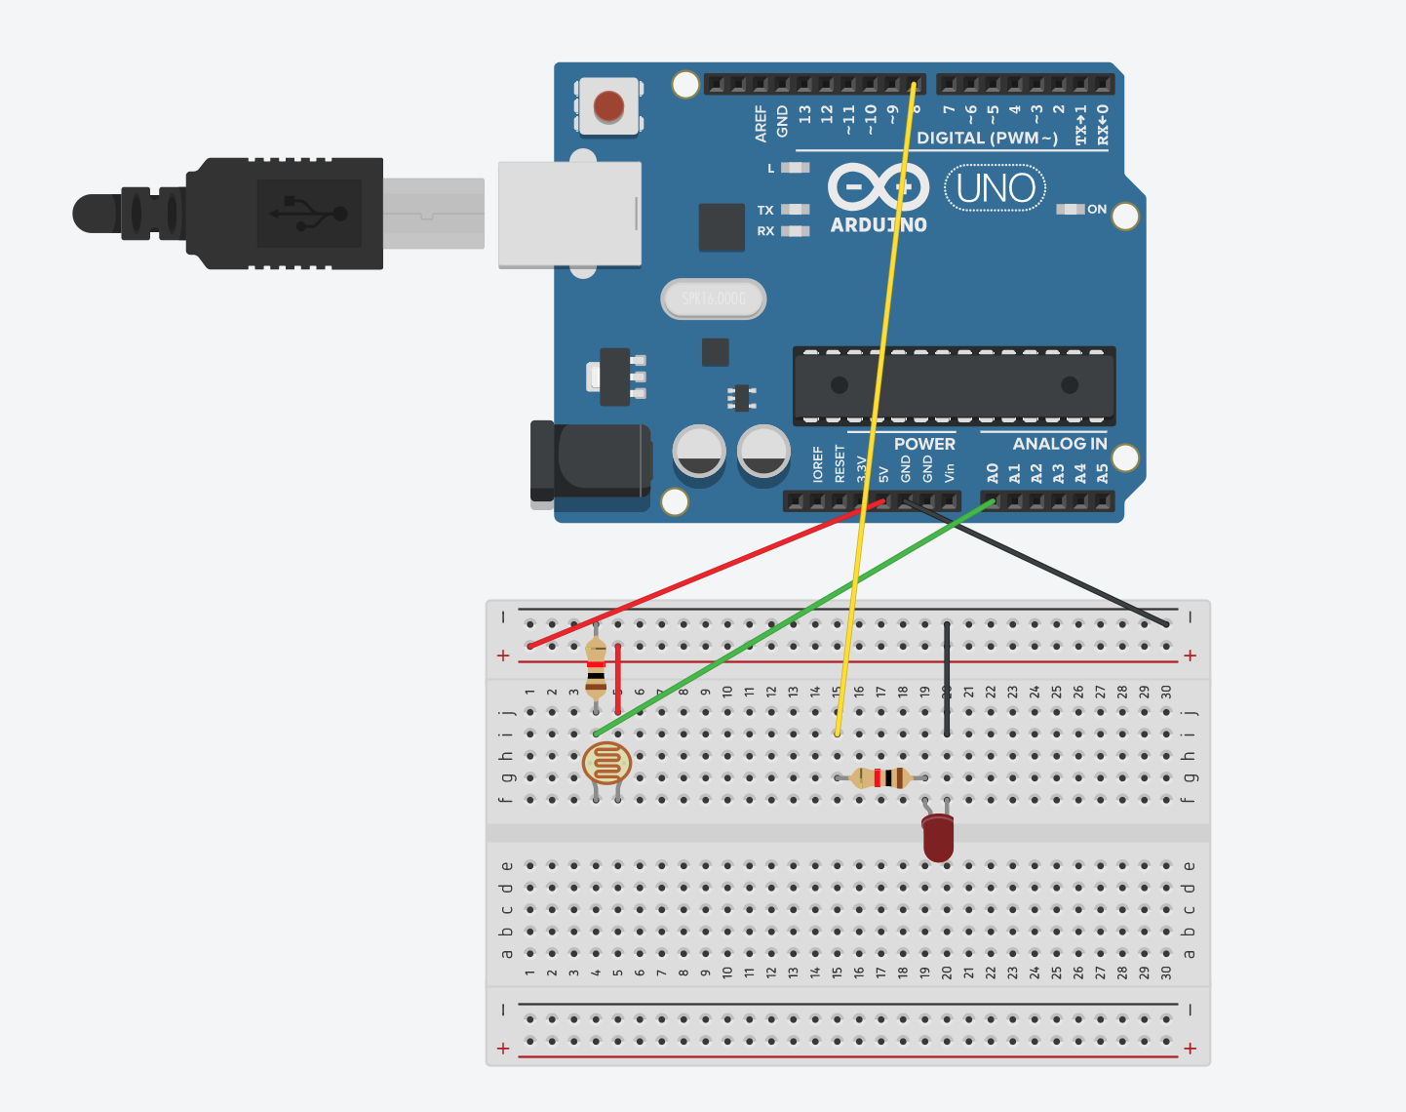
Light-based LED

